Slide 1


Slide 2
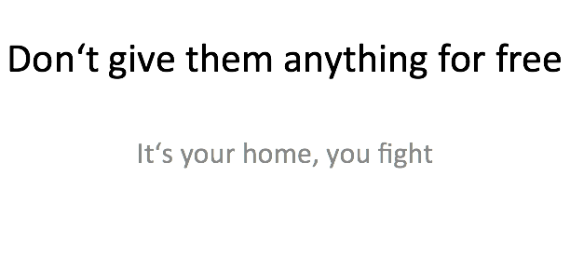

Slide 3




BetterCrypto⋅org
Applied Crypto Hardening
David Durvaux
Aaron Kaplan
Brussels, 9th June 2014

Slide 4
Who
Wolfgang Breyha (uni VIE),
David Durvaux (CERT.be),
Tobias Dussa (KIT-CERT),
L. Aaron Kaplan (CERT.at),
Christian Mock (coretec),
Daniel Kovacic (A-Trust),
Manuel Koschuch (FH Campus Wien),
Adi Kriegisch (VRVis),
Ramin Sabet (A-Trust),
Aaron Zauner (azet.org),
Pepi Zawodsky (maclemon.at),
New contributors:
IAIK,
A-Sit

Slide 5
Agenda
Pieces of History
Introduction to BetterCrypto project
Cryptography in a nutshell
Practical Settings
Testing
Demo
Conclusion

Slide 6

Pieces of History

Slide 7
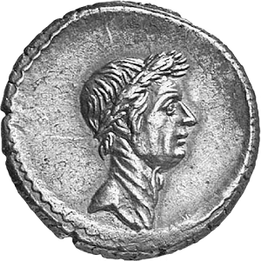
Caesar
Vigenère Cipher

Slide 8
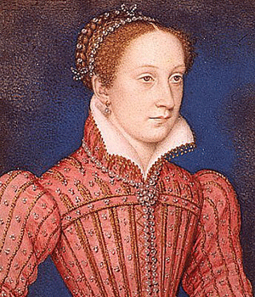
Mary Queen of Scots
Trial against Queen Elizabeth
Was executed after her code was broken (1587)

Slide 9
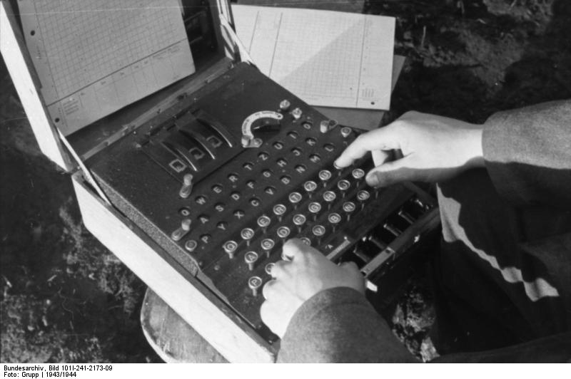
Enigma
Secret in code book

Slide 10
BetterCrypto

Slide 11
Why?
Crypto is cryptic
A lot of difficult concepts
A lot of algorithms
A lot of parameters
…

Slide 12
The Idea
Really difficult for systems administrators
A “cookbook” can help!
That’s BetterCrypo

Slide 13
That’s not…
A crypto course
A static document

Slide 14
In short
Community effort to produce best practices
Continuous effort
Mixed expertises
Open to comments / suggestions / improvements

Slide 15
2 parts
First part = configurations
The most important part
Cover as many tools as possible
Second part = theory
Explain and justify choose we made
Transparency

Slide 16
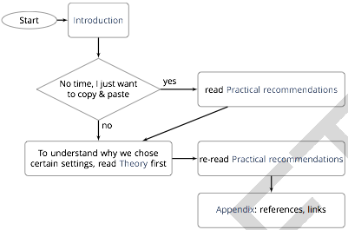
How to use?

Slide 17
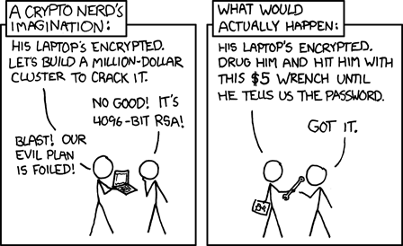
Crypto in a nutshell

Slide 18
Goals
2 types of goals:
protect the contact of the message
identify the author
Can be combined

Slide 19
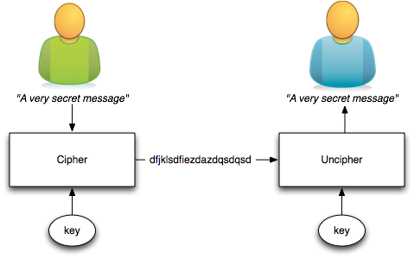
Symetric Ciphering
The key is shared

Slide 20
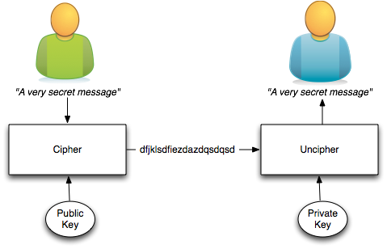
Asymetric Ciphering
Public key is published
Private key HAS to be secured

Slide 21
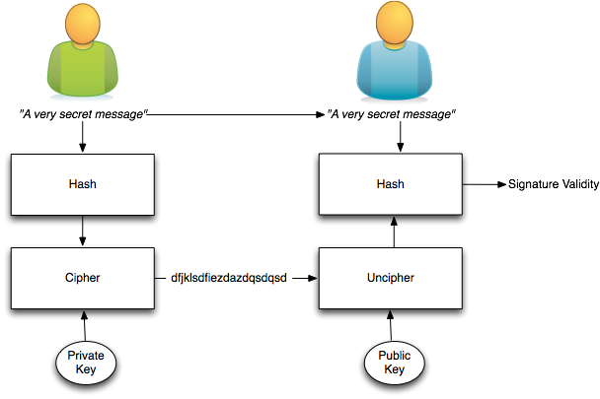
Signing
Author identity is proved

Slide 22
The asymmetric magic
RSA “formula” :
with
c which is the ciphertext
m is the cleartext message
e and n are the public key
Uncipher with
d being the private key

Slide 23
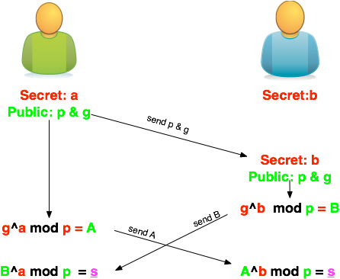
Diffie-Helleman
How to share a secret key?

Slide 24
Ephemeral Diffie-Helleman
Regular mode
Public and private keys are kept
Ephemeral mode
New keys are generated each time
By one of the parties at least

Slide 25
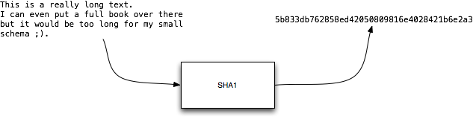
Hashing
Take long piece of data and produce a probably unique signature
Probability of collision for SHA1:
1 over 1461501637330902918203684832716283019655932542976

Slide 26
ECC
Elliptic curve cryptography (ECC)
Finding the discrete logarithm of a random elliptic curve element
Only knowing a base point
Assumed to be infeasible
Reduced key length

Slide 27
Some thoughts on ECC
Currently this is under heavy debate
Trust the Math
“Nothing Up My Sleeve Numbers”
eg. NIST P-256 (http://safecurves.cr.yp.to/rigid.html)
Coefficients generated by hashing the unexplained seed c49d3608 86e70493 6a6678e1 139d26b7 819f7e90.
Might have to change settings tomorrow
Most Applications only work with NIST-Curves

Slide 28
SSL
[Explain]

Slide 29

Forward Secrecy-Motivation:
Three letter agency (TLA) stores all ssl traffic
Someday TLA gains access to ssl-private key (Brute Force, Physical Force)
TLA can decrypt all stored traffic

Slide 30
Perfect Forward Secrecy
DHE: Diffie Hellman Ephemeral
Ephemeral: new key for each execution of a key exchange process
SSL private-Key only for authentication
Alternative new ssl private key every x days months
Pro:
Highest Security against future attacks
Contra:
Elliptic Curve
Processing costs

Slide 31
Stream vs Block Cipher
Stream cipher
Generate an “infinite” key stream
Difficult to correctly use
Re-use of keys
Faster
Block cipher
Cipher by block with padding
Could include integrity protection

Slide 32
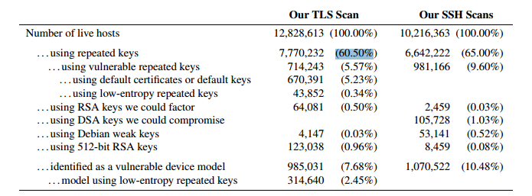
RNGs
RNGs are important.
Nadia Heninger et al / Lenstra et al
Entropy after startup: embedded devices

Slide 33
RNGs
Weak RNG
Dual EC_DRBG is weak (slow, used in RSA-toolkit)
Intel RNG ? Recommendation: add System-Entropy (Network). Entropy only goes up.
Tools (eg. HaveGE http://dl.acm.org/citation.cfm?id=945516)
RTFM
when is the router key generated
Default Keys ?
Re-generate keys from time to time

Slide 34
Some algorithms
Symetric Ciphering
DES / 3DES
AES (Rijndael)
Camellia
Asymetric Ciphering
RSA
PGP (GPG)

Slide 35
Some algorithms
Hash
SHA1
SHA256
SHA512
Key Exchange
Diffie Helleman

Slide 36
Algorithm vs Implementation!
Heartbeat

Slide 37
Heartbeat
/* Enter response type, length and copy payload */
*bp++ = TLS1_HB_RESPONSE;
s2n(payload, bp);
memcpy(bp, pl, payload);
payload (pl) and payload_length (payload) are controlled by attacker
memcpy will copy a part of the victim memory to the reply…

Slide 38
Cost of encryption
AES via GPG – TODO!!

Slide 39
Keylengths
On the choice between AES256 and AES128: I would never consider using AES256, just like I don’t wear a helmet when I sit inside my car. It’s too much bother for the epsilon improvement in security.”
— Vincent Rijmen in a personal mail exchange Dec 2013

Slide 40
Keylengths
http://www.keylength.com/
Recommended Keylengths, Hashing algorithms, etc.
Currently:
RSA: >= 3248 bits (Ecrypt II)
ECC: >= 256
SHA 2+ (SHA 256,…)
AES 128 is good enough

Slide 41
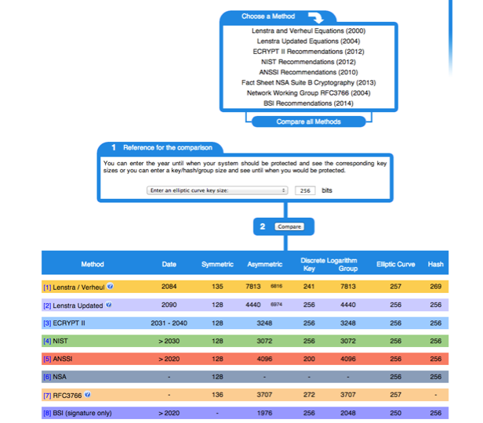

Slide 42
BetterCrypto CipherSuite
2 cipher suites
version A
stronger
less supported client
version B
weaker
more “universal”

Slide 43
Some general thoughts on settings
General
Disable SSL 2.0 (weak algorithms)
Disable SSL 3.0 (BEAST vs IE/XP)
Enable TLS 1.0 or better
Disable TLS-Compression (SSL-CRIME Attack)
Implement HSTS (HTTP Strict Transport Security)

Slide 44
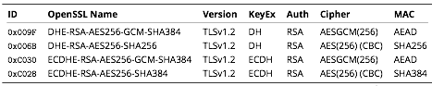
Cipher Suite A
TLS 1.2
Perfect forward secrecy / ephemeral Diffie Hellman
Strong MACs (SHA-2) or
GCM as Authenticated Encryption scheme

Slide 45
CiperSuite B
TLS 1.2, TLS 1.1, TLS 1.0
Allowing SHA-1

Slide 46
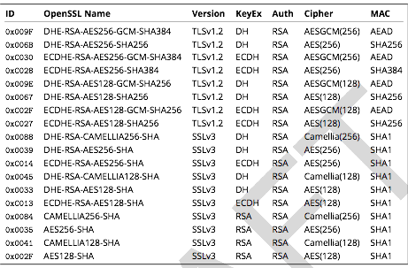
Cipher Suite B

Slide 47
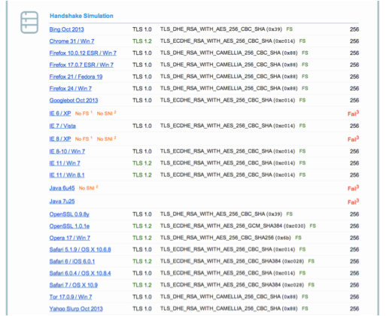
Compatibility (B suite)

Slide 48

Practical Settings

Slide 49
Tools covered
Webservers
Apache
lighttpd
nginx
Microsoft IIS

Slide 50
Tools covered
SSH
Open SSH
Cisco ASA
Cisco IOS

Slide 51
Tools covered
Mail servers
Dovecot
cyrus-imapd
Postfix
Exim

Slide 52
Tools covered
VPN
IPSec
CheckPoint Firewall-1
OpenVPN
PPPTP
Cisco ASA
OpenSWAN
tinc

Slide 53
Tools covered
PGP/GPG
IPMI/ILO
Instant Messaging
ejabberd
OTR
Charybdis
SILC

Slide 54
Tools covered
Database systems
Oracle
MySQL
DB2
PostgreSQL

Slide 55
Tools covered
Proxy
squid
Bluecoat
Pound
Kerberos

Slide 56
Mail Encryption
GPG / PGG
[ a little bit over there ]

Slide 57
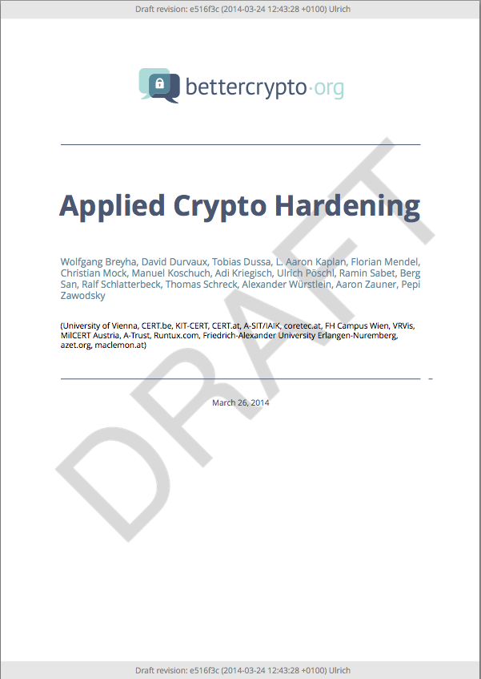
Let’s have a look

Slide 58
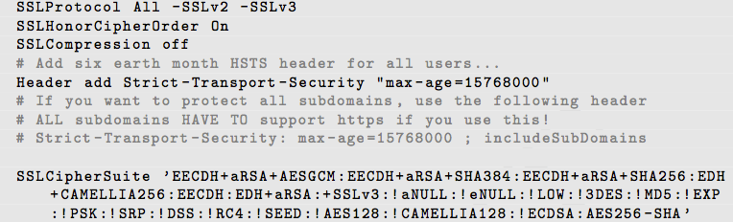
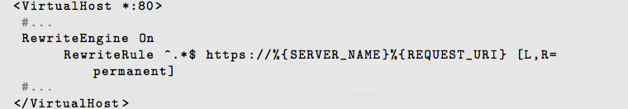
Apache
Selecting cipher suites:
Additionally:
Aaron

Slide 59
Testing

Slide 60
How to test? - Tools
openssl s_client (or gnutls-cli)
ssllabs.com: checks for servers as well as clients
xmpp.net
sslscan
SSLyze

Slide 61
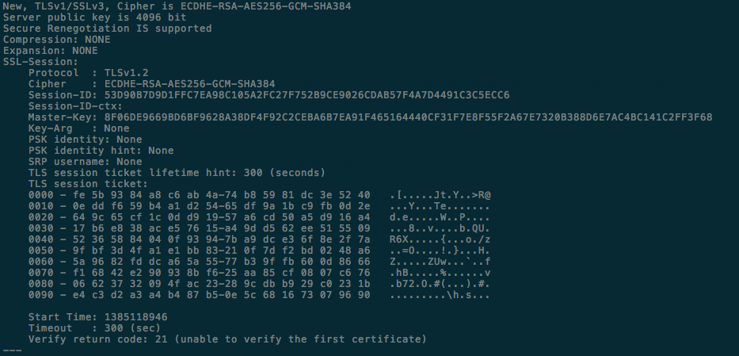
Tools: openss s_client
openssl s_client -showcerts –connect git.bettercrypto.org:443

Slide 62
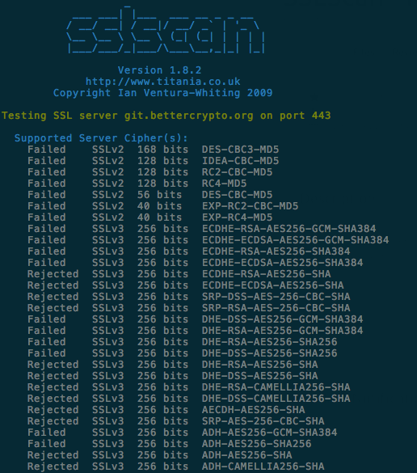
Tools: sslscan

Slide 63
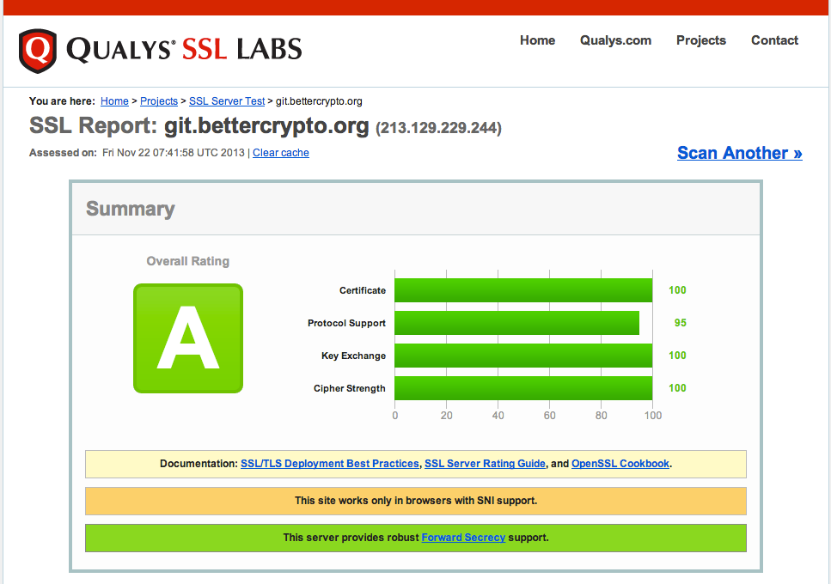
Tools: ssllabs

Slide 64
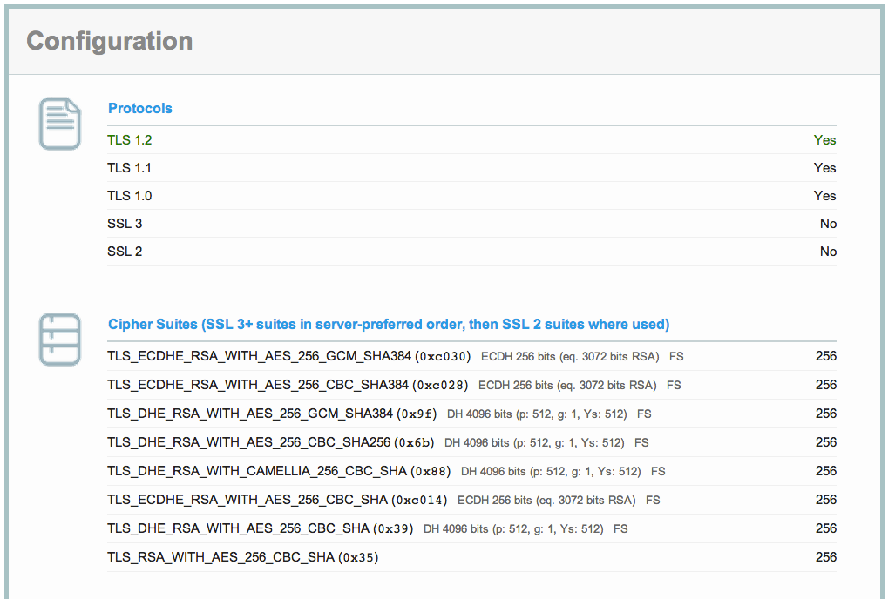
ssllabs (2)

Slide 65
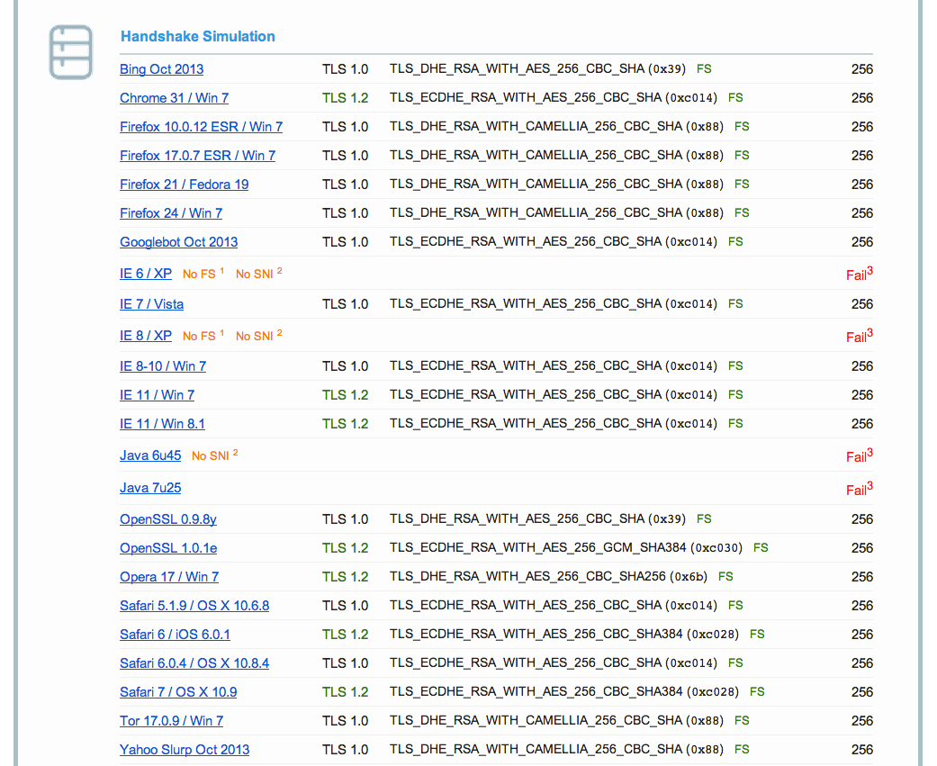
Ssllabs (3)

Slide 66
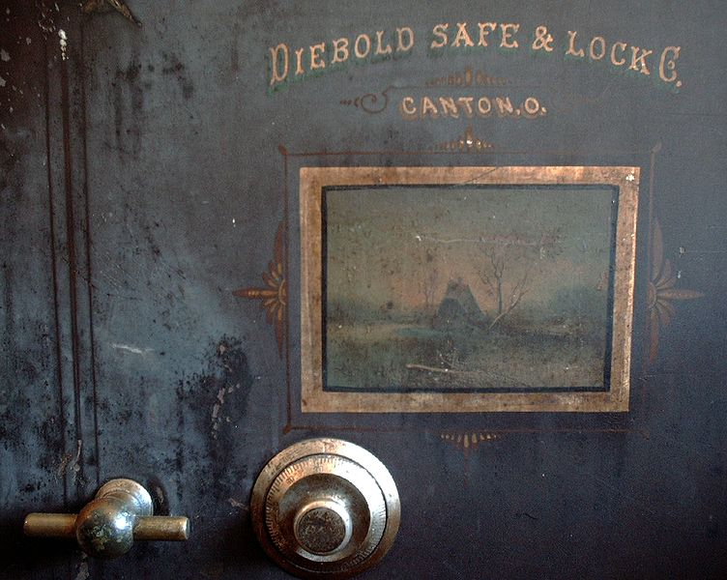
Demo

Slide 67
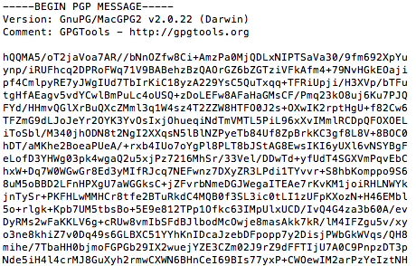
GPG - Ciphering
echo "This is a really secret" \ | gpg -a -u 57AB3358 -r E84A32A0 -e

Slide 68
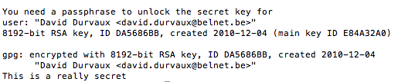
GPG - Unciphering
Let’s save the ciphered text to msg.asc
Then uncipher…
gpg -d msg.asc

Slide 69
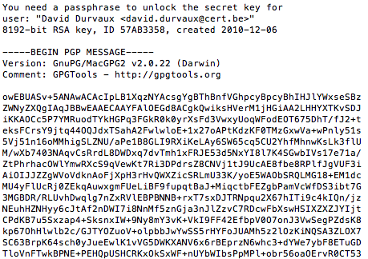
GPG - Signing
echo "This is a really secret" \ | gpg -a -u 57AB3358 -r E84A32A0 -s

Slide 70
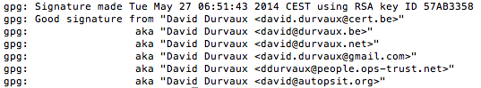
GPG – Check Signature
gpg --verify sig.asc
Differents way to sign / verify:
https://www.gnupg.org/gph/en/manual/x135.html
Other techniques
Clearsigned Documents
Detached Signatures

Slide 71
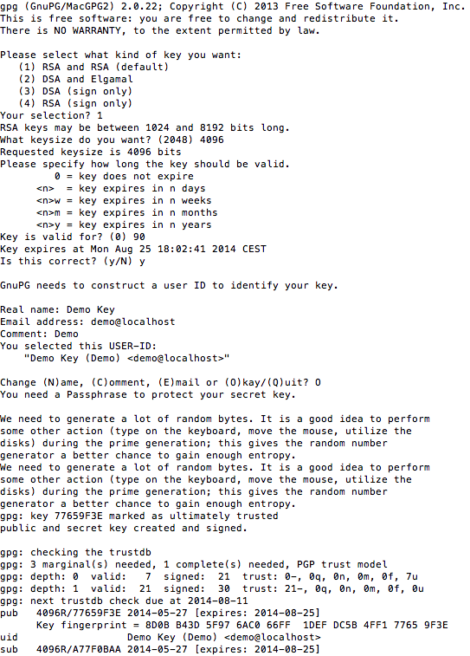
GPG Key generation
gpg --gen-key
Kind of Key
Keylenght
Expiration Period

Slide 72
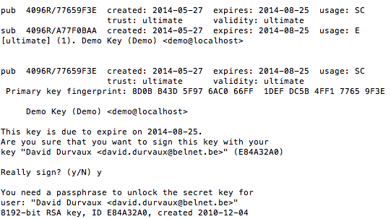
GPG – Key signing
gpg --sign-key -u E84A32A0 77659F3E

Slide 73

GPG – Let’s do it!
Let’s do a key party!

Slide 74
GPG – Sending key
xxxx

Slide 75
GPG - Integration
Enigmail (Thunderbird)
GPGMail (Apple Mail)
Symantec PGP
…

Slide 76
Other nice user tools
TrueCrypt
KeePass

Slide 77
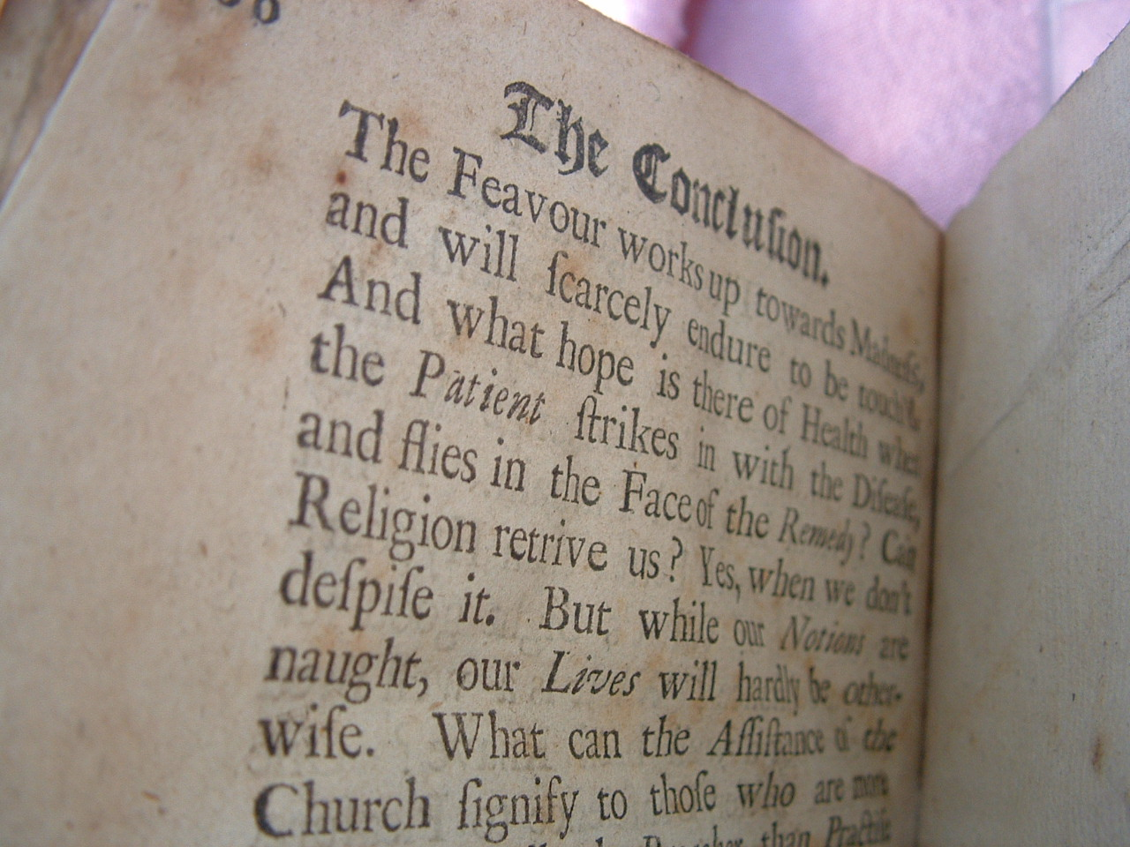
Conclusion

Slide 78
Futur / Idea
Configuration Generator (online)
A friendly copy/paste version
Other tools

Slide 79
Conclusion

Slide 80
Thanks you!
BetterCrypto.org
https://git.bettercrypto.org/ach-master.git
http://lists.cert.at/cgi-bin/mailman/listinfo/ach
Contact
aaron@XXX.org — [TWITTER]
david@autopsit.org — @ddurvaux

